Slide 1
LOCATING AN AFRICAN RESTAURANT IN TORONTO
MOSES ADINFONO

Slide 2
Background
Have you ever relocated to a new country and wanted a taste of the meal back home? A number of people, after arriving in a new country, look for where they can get meals close to what they experience back home (the country they came from). This, among many other reasons, gave birth to the establishment of restaurants like: Chinese Restaurants, Italian restaurants and the likes.
Canada is one of the leading countries in policies that favor immigration. When immigrants arrive in Canada, the prime city of choice is usually Toronto.
I have a few friends in North York, Toronto. They tell me time and again that they wish they had a restaurant that would serve them some African dishes.

Slide 3
Problem Statement
This project aims to find the best neighborhood in North York Toronto to setup a New African Restaurant for immigrants from Africa and others who want to have a taste of delicious African delicacies.

Slide 4
Data
For this project, we will combine three datasets to achieve our goal.
The first source of data is Wikipedia. We will scrap the Wikipedia website for neighborhoods in Toronoto using Beautiful Soup.
We will then use data of geographical coordinates gotten from previous exercises in this program.
And finally, we will use the Foursquare location data to solve the problem or execute your idea. You can absolutely use other datasets in combination with the Foursquare location data.

Slide 5
Methodology
Acquiring dataset.
Cleaning the dataset.
Accessing the coordinates
Visualizing the dataset.
Using Foursquare API to access the Venue Category.
Selecting hotels from the Venue Category.
Use K-means cluster algorithms to cluster the result
Visualize the results
Analyze the results.

Slide 6
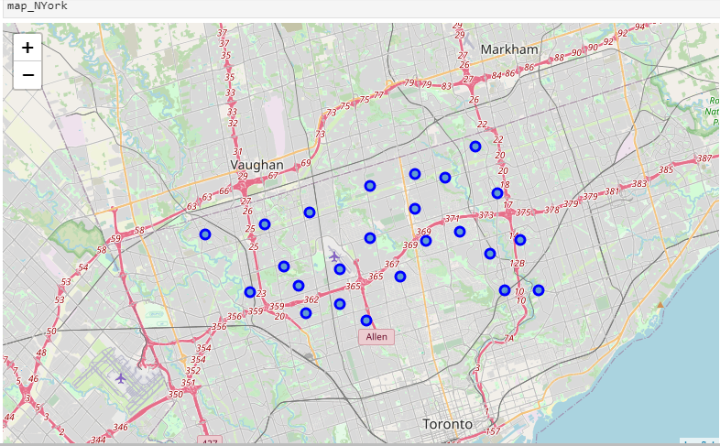
Visualization: Pre-Clustering

Slide 7
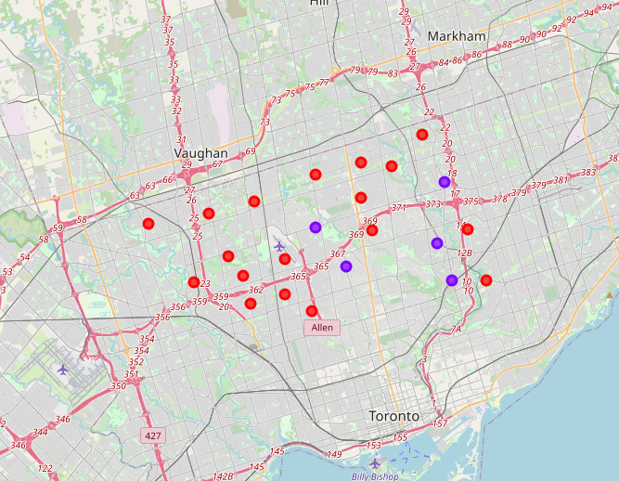
Visualization: Post Clustering

Slide 8
Observations
We notice very easily that Cluster 1 happens to be more saturated, with 18 similar points, than Clusters 2 with just 5 similar points.
We had also initially observed that there were no African Restaurants in this Neighborhood of Toronto.

Slide 9
Inference
Neighborhoods in Cluster 2, like Don Mills, Bedford Park, Oriole, etc., would be my recommendation for anyone looking to set up an African Restaurant in North York, Toronto. This is because the restaurant would very easily stand out and be noticed as there isn’t much completion in these locations.

